Slide 1
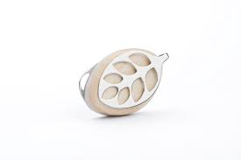


WELLNESS FOR ALL WITH DATA
Presented by:
Vellaiyathambi A
Last Update on:14/6/2021

Slide 2
CONTENT OVERVIEW
The Fitness Industry(History and Trends)
The Objective at hand
Background of the Analysis
The Trends within the data
Key Takeaways and Recommendations
Appendix

Slide 3
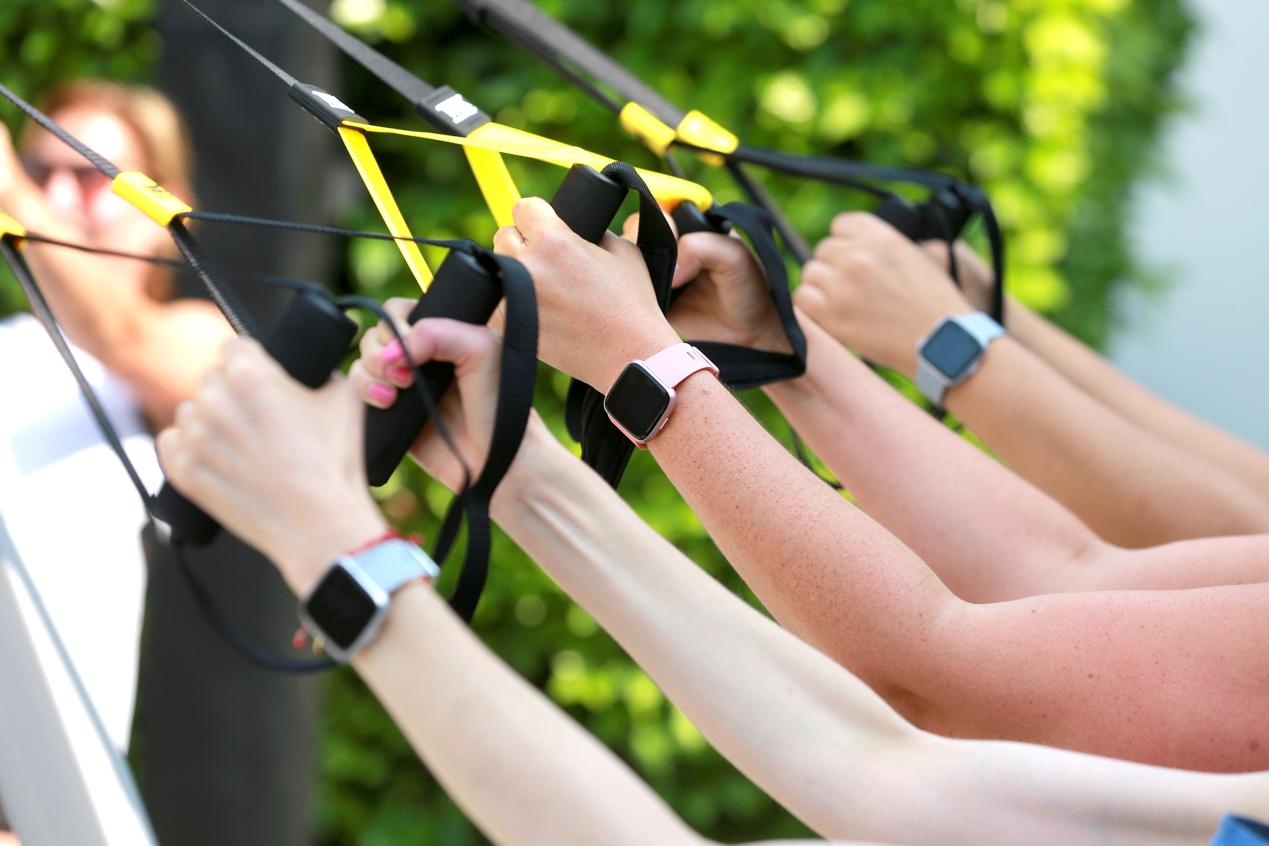
The Fitness Industry(History and Trends)

Slide 4
The popularity around supplementary physical activities are at a all time high enabling the fitness Industry to hit an all-time height of roughly 134.34 Billion dollars in worth.
The Wearable fitness market is worth expected to grow at a Compound Annual Growth Rate of 15.4%
The wearable fitness market itself is set to reach new heights with estimates putting the numbers at around 114.36 Billion dollars by 2028 according to “Fortune Business Insights”.
The impressive figures and growth potential could enable Bellabeat to carve its own legacy in the fitness revolution.

Slide 5

THE OBJECTIVE AT HAND

Slide 6
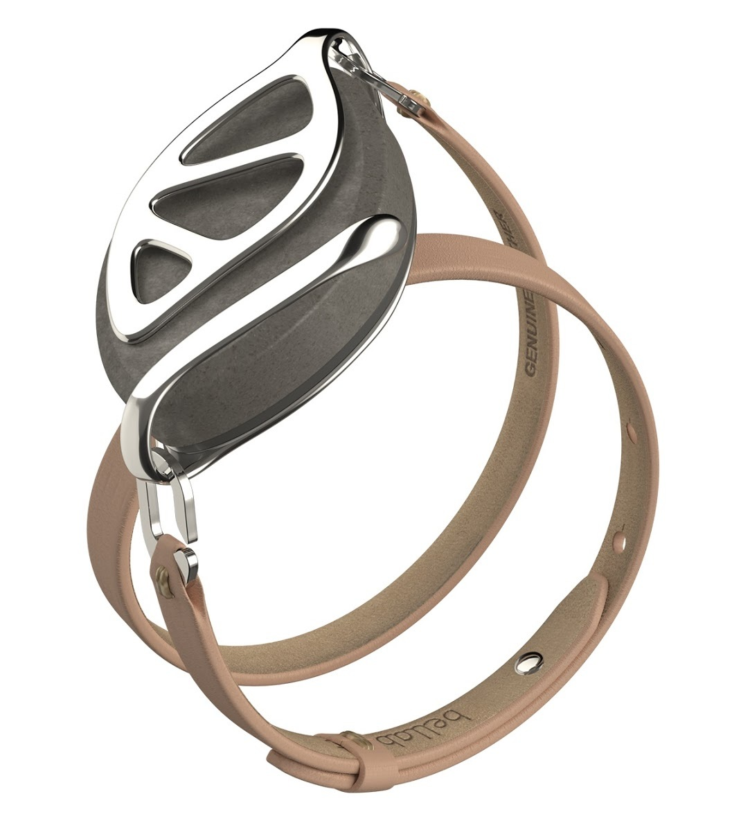
Analyzing User data to gain insights to drive the marketing strategy for a Bellabeat product.

Slide 7
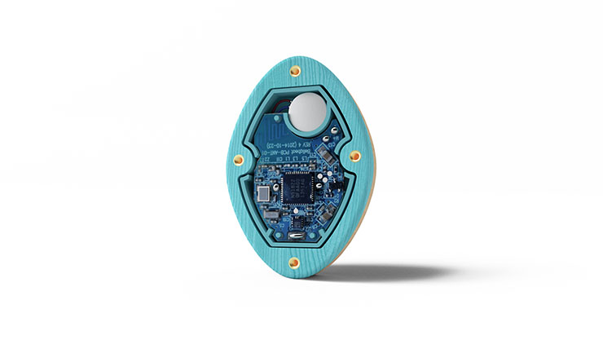
BACKGROUND OF THE ANALYSIS

Slide 8
Analysis uses the dataset https://www.kaggle.com/arashnic/fitbit/activity from Kaggle
The data has been collected from Fitbit users with their consent using the Amazon Mechanical Turk
The scope of the Data set is limited as data is available only for 33 unique users
The Analysis recommendations would be applied to the marketing of the Bellabeat leaf

Slide 9
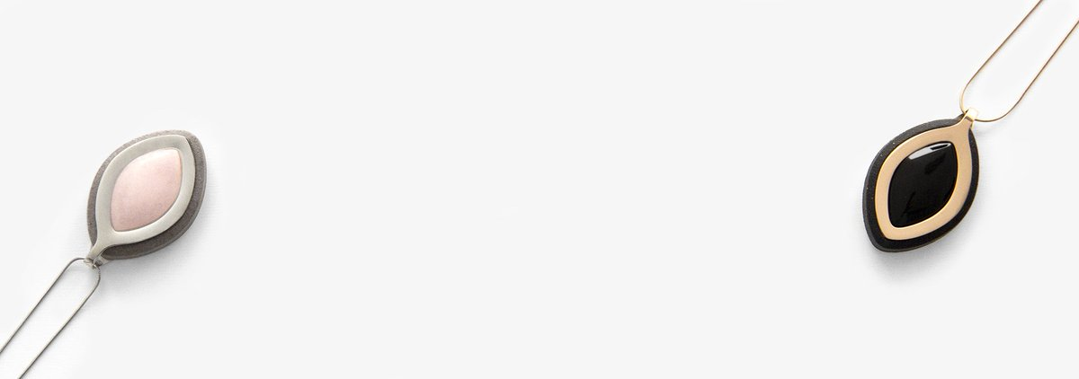
TRENDS WITHIN THE DATA

Slide 10
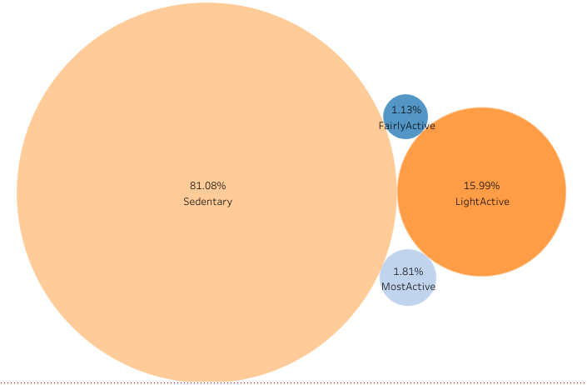
How people spend their time?
ANALYSIS
People are sedentary 81.08% of the time while wearing their Fitbit
People are at their most active only 1.18% of the time while wearing their Fitbit
TAKEAWAYS
People use their fitness devices mostly as lifestyle accessories

Slide 11
How many days has the device been taken off?
ANALYSIS
15 % of the users have taken off their device without turning it off for 10 days
41 % of the users have taken their device off for at-least a day.
TAKEAWAYS
There is a high percentage of the userbase not wearing the tracker everyday thus missing on insights.

Slide 12
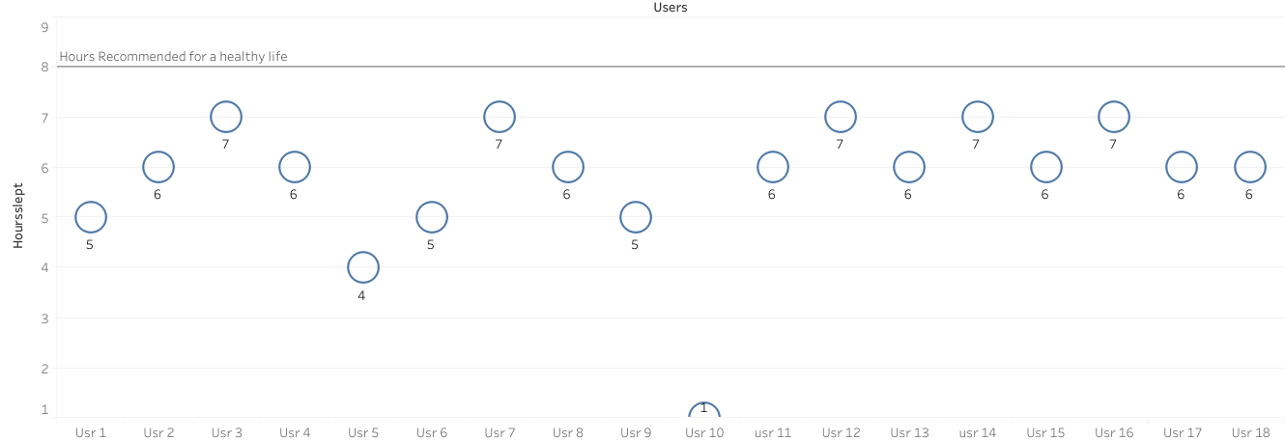
How are we sleeping?
ANALYSIS
No Fitbit user in the data set gets the recommended 8 hours of sleep
33 % of the users do not use the sleep tracking feature.
TAKEAWAYS
People are constantly sleep deprived ,also there is a low adoption of sleep tracking feature.

Slide 13
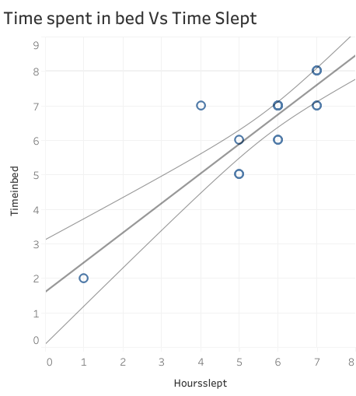
How long do people take to fall asleep?
ANALYSIS
Users take an average one hour to fall asleep
“The normal time it takes most people to fall asleep at night is between 10 and 20 minutes” -Healthline
TAKEAWAYS
People are finding it hard to fall asleep

Slide 14
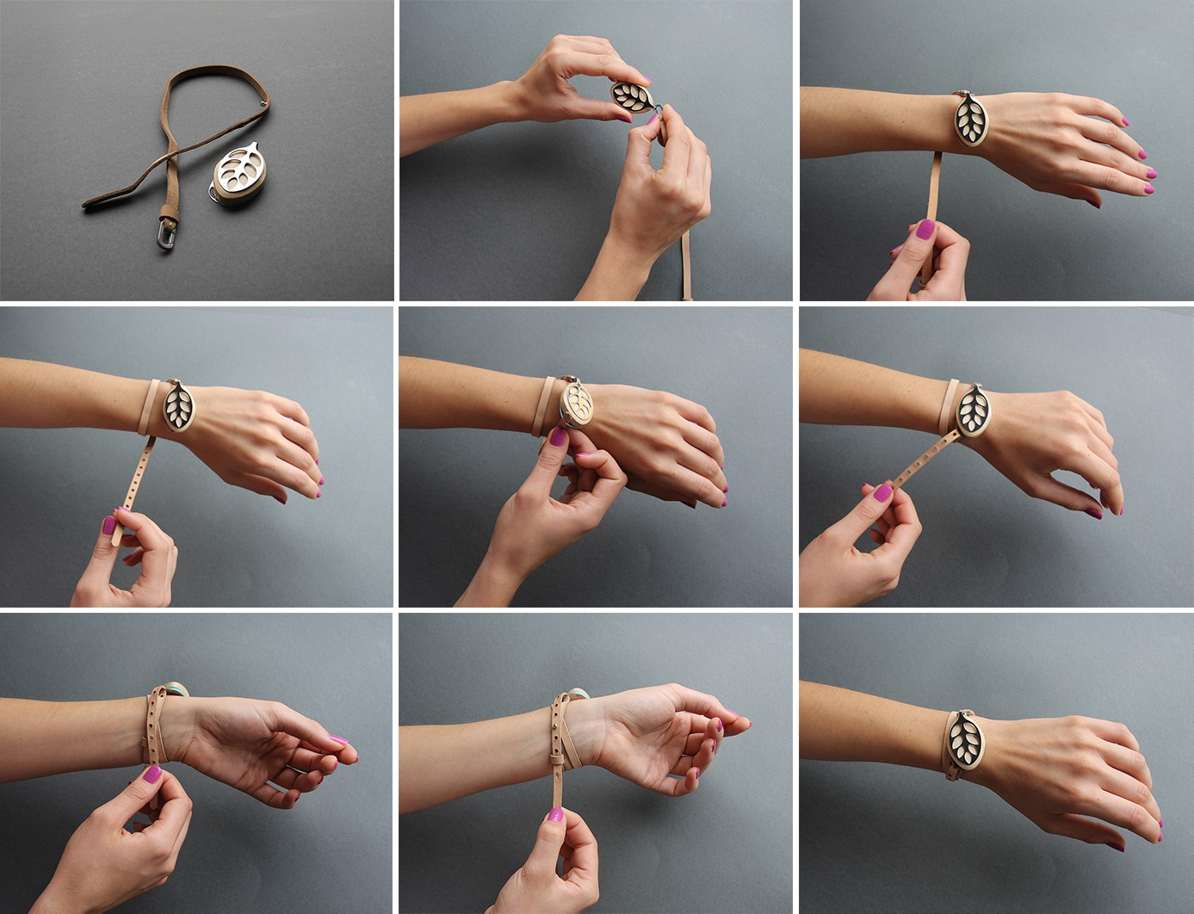
KEY TAKEAWAYS AND RECOMMENDATIONS

Slide 15
KEY TAKEAWAYS
People use their fitness devices mostly as lifestyle accessories
There is a high percentage of the userbase not wearing the tracker everyday thus missing on insights
People are constantly sleep deprived
There is a low adoption of sleep tracking feature.
People are finding it hard to fall asleep
RECOMMENDATIONS
The Bellabeat leaf, aligning with the trend could be marketed as a lifestyle product with emphasis on its design.
The Bellabeat leaf could be marketed as a wear and forget gadget that eliminates the effort of wearing a dedicated watch or a tracker
The Bellabeat leaf’s unobtrusive design, advanced sleep tracking of the Bellabeatleaf ,versatility in its form factor could make it a perfect candidate to be marketed as a sleep tracker for people who value comfort with insight.
This could help Bellbeat fill the vacancy in the sleep tracker market.

Slide 16
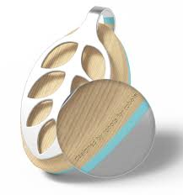
APPENDIX

Slide 17
TOOLS AND PROCESSES
Microsoft SQL Server
Microsoft SQL Server was employed for Data Cleaning and Analysis
Tableau
Tableau was the primary tool for visualization
Excel
Excel was used primarily for importing datasets to excel from SQL as Tableau public did not allow the same
A solitary Visualization was also made using Excel.

